Slide 1
GeoNetwork DCAT-AP Schema plugin
Joachim Nielandt

Slide 2
Overview
DCAT-AP schema plugin for GeoNetwork
Goals
Native editor for DCAT records
Supports multiple profiles
Conditional validation
View that works out of the box
Multilingual
Originally Flemish-specific plugin
Made generic through joint-effort
Proposed and developed through multiple cycles

Slide 3
Development
Repository: https://github.com/metadata101/dcat-ap
Single repository for all profiles
Share improvements
Prevents orphaned efforts
Branch management
main for current state of generic development
profile/xx/main for specific deployment’s (member state) development
Under discussion: how to align with GeoNetwork versions
Compatibility
Current work based on GeoNetwork 4.4.6
4.4.7 upgrade is pending

Slide 4
Flanders
Development
Current state
VL currently uses metadata101/dcat-ap in production
Tracks profile/vl/main and syncs with main
Only need for custom profile was due to drift of GeoNetwork’s pom.xml version

Slide 5
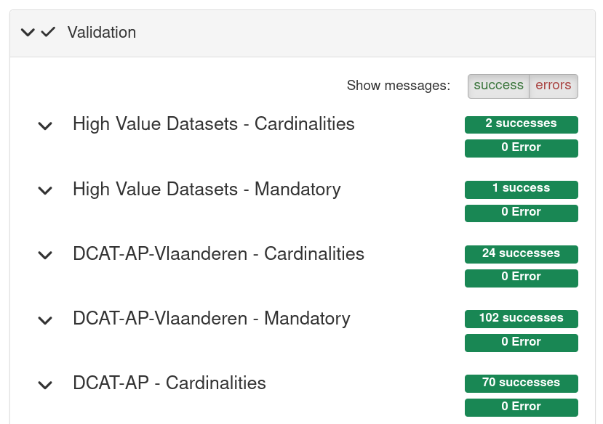
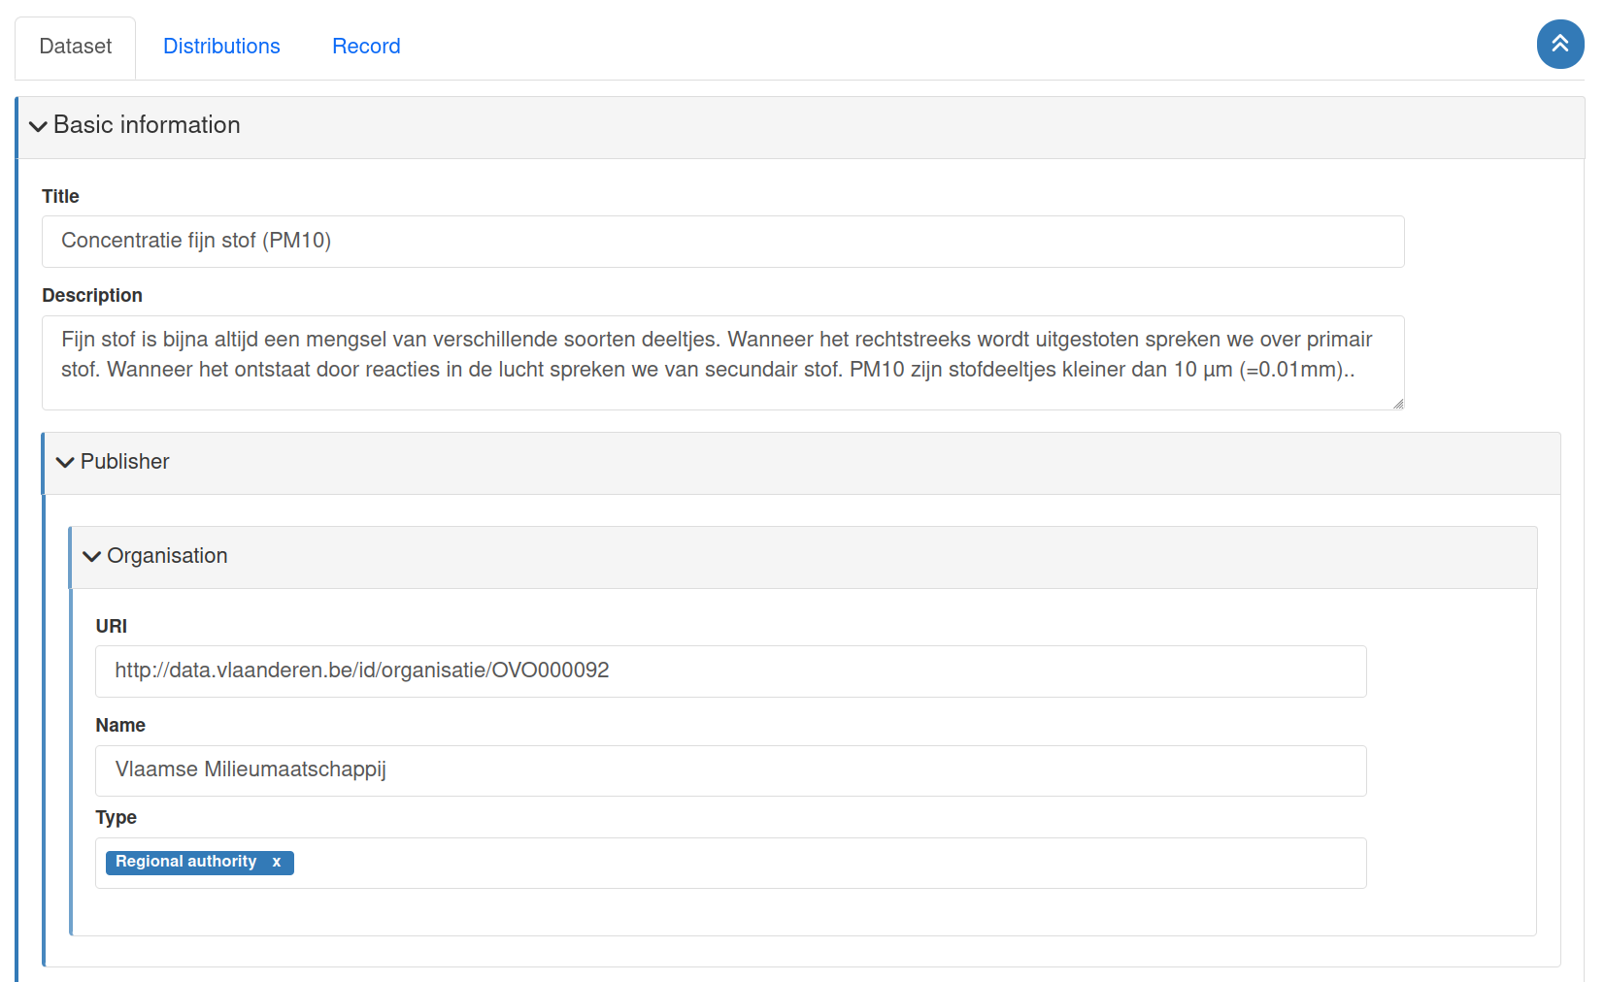
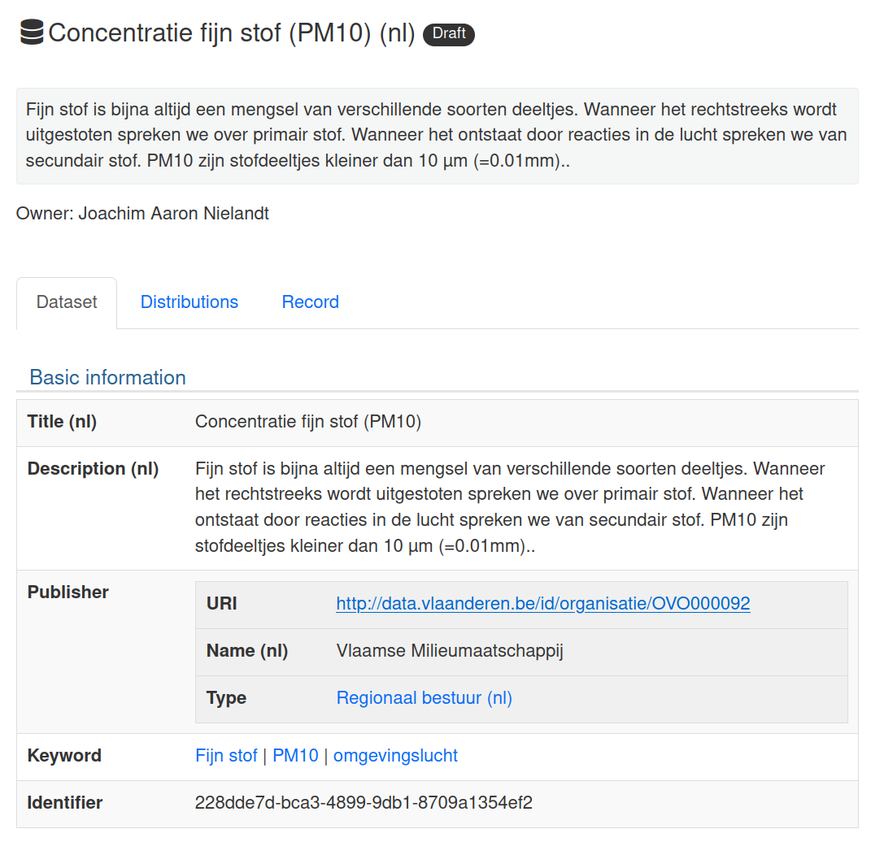
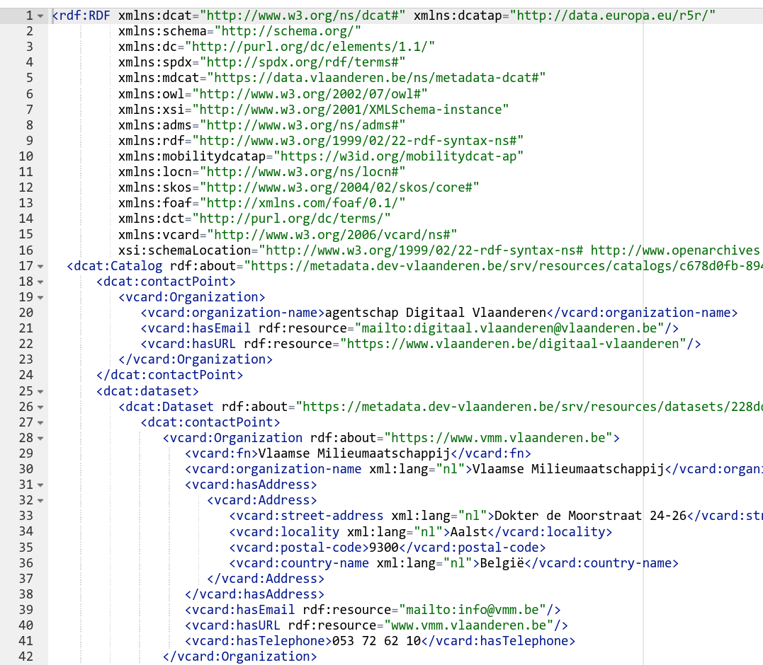
Flanders
Development

Slide 6
Multiple profiles
Current setup makes use of dct:conformsTo/dct:Standard to check profile of record
Editor displays elements conditionally based on profile
GeoNetwork view is based on the editor configuration
Validation is based on multiple schematrons
Separate schematrons per profile
Conditionally applied depending on the profile of the record

Slide 7
Currently supported
Multiple profiles
Bare DCAT-AP2
Belgium>Flanders
DCAT-AP Vlaanderen (https://data.vlaanderen.be/doc/applicatieprofiel/DCAT-AP-VL/)
Metadata DCAT (https://data.vlaanderen.be/doc/applicatieprofiel/metadata-dcat/)
European
DCAT-AP High Value Datasets (https://semiceu.github.io/DCAT-AP/releases/2.2.0-hvd/)

Slide 8
Future
Multiple profiles
Issues
Version management of plugin, e.g., following GeoNetwork’s version
How to deal with multiple versions of profiles, e.g., DCAT2 > DCAT3?
Profiles
Work in progress: DCAT3
Proof of concept work: DCAT-AP-NL
Interest in mobilityDCAT-AP
Interest in HealthDCAT-AP

Slide 9

Questions? joachim.nielandt@vlaanderen.be stijn.tallir@vlaanderen.be

